Slide 1

Machine Learning and
Deep Learning Project
Bank’s Churn Dataset
-By Bindiya Singh

Slide 2
INDEX
Business Problem
Data Preprocessing
Exploratory Data Analysis
Correlation Matrix
Model Training and Hyperparameter Tuning
Model Evaluation
Recommendation
Conclusion

Slide 3

Bank’s Churn Dataset
Business Problem: ABC Multistate bank is concerned about customers leaving their Banking services.
The goal of this analysis is to create a model that returns the probability of a customer to churn. This prediction will help the bank proactively engage with at-risk customers, provide better services, and ultimately reduce customer churn.
Sr no | Name | Description
1 | CustomerID | Identity number of each customer
2 | RowNumber | Identity number of each row
3 | Surname | Last name of customer
4 | CreditScore | Credit Score of customer
5 | Geography | Country of Residence
6 | Gender | Gender of the customer
7 | Age | Age of the customer
8 | Tenure | How long they have been using account
9 | Balance | Amount in account
10 | NumOfProducts | The number of bank products used
11 | HasCrCard | Has a credit Card
12 | IsActiveMember | Is actively operating with the Bank
13 | EstimatedSalary | Salary estimated by bank
14 | Exited | Terminated their Banking relationship

Slide 4
Data Preprocessing and Feature Engineering
Data Cleaning
14 Features
Data Normalization
Data Binning
4 Features
4 Features
Data Transformation
2 Features
Dropped Irrelevant Features
3 Features
4 Features | 3 Features | 4 Features | 2 Features
Balance | RowNumber | Balance | Gender
Age | CustomerID | Age | Geography
CreditScore | Surname | CreditScore
EstimatedSalary |  | EstimatedSalary

Slide 5
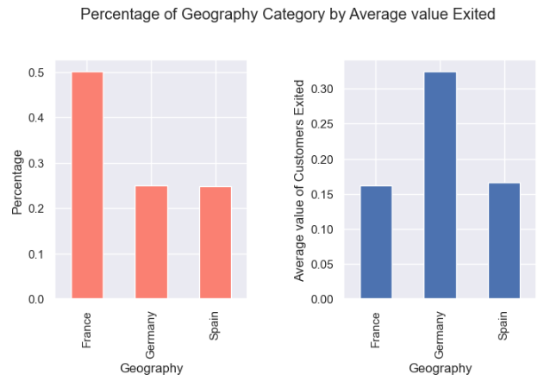
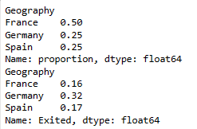
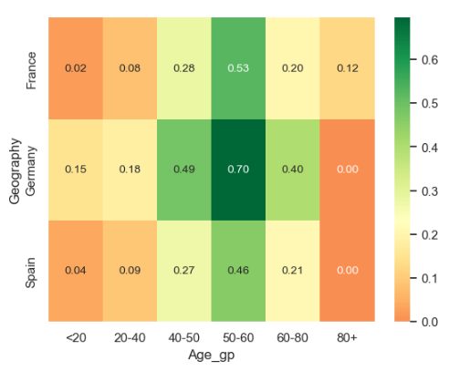
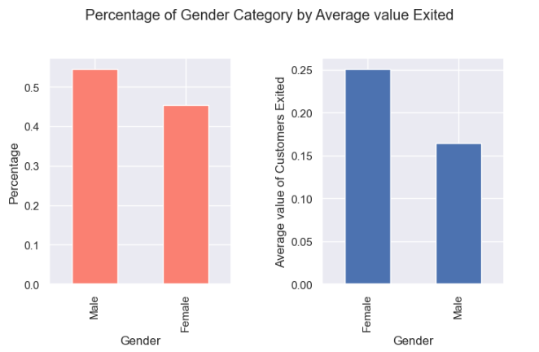
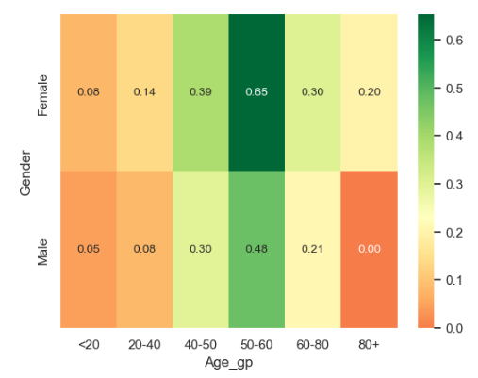
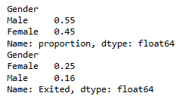
Exploratory Data Analysis
Comparison of Independent Variables with Dependent Variable ( ‘Exited’)
Geography – Exited Status
Geography , Age by Exit status
Conclusion :
Customers from Germany are more likely to Exit as compared to France and Spain. In Germany , maximum customers between age group 50-60 have churned . (Chi-square test)
Gender – Exited Status
Gender , Age by Exit status
Conclusion :
Female customers are more likely to exit compared to males. 65% of the total female customers are between 50-60 age group.
(Chi-square test)

Slide 6
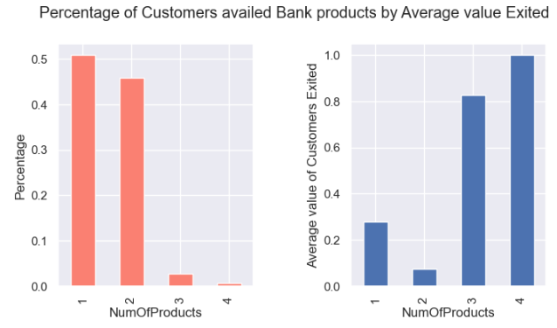
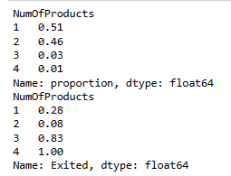
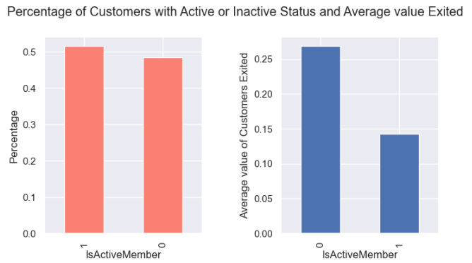
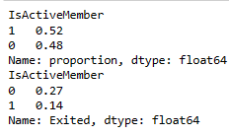
Exploratory Data Analysis
NumOfProducts – Exited Status
Conclusion :
The customers holding 3 to 4 Bank products are more likely to churn .
(Chi-square test)
IsActiveMember– Exited Status
Conclusion :
The customers with inactive status are more likely to churn.
(Chi-square test)

Slide 7
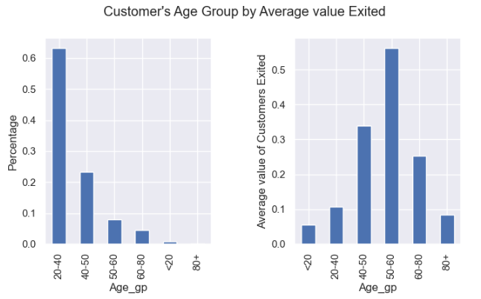
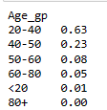
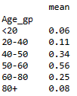
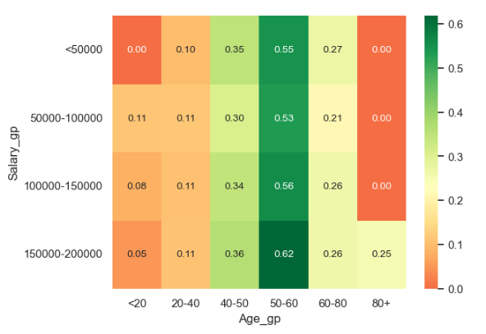
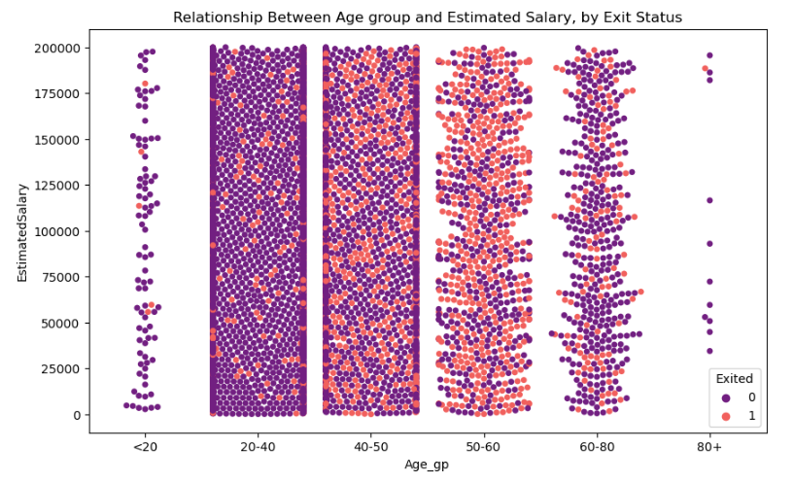
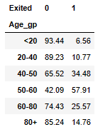
Exploratory Data Analysis
Age Group – Exited Status
The analysis shows that the customers, particularly those in the 40-50 and 50-60 age groups, have higher exit rates compared to younger age groups.
Age , Salary by Exit Status

Slide 8
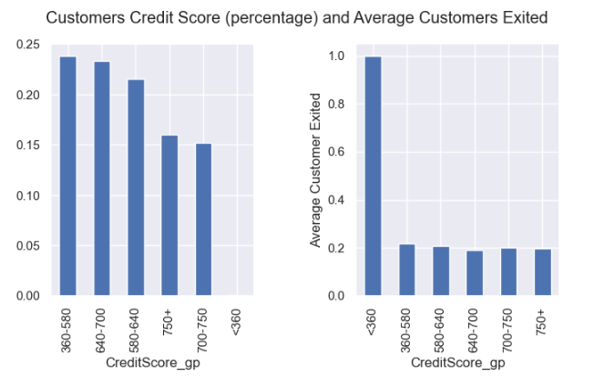
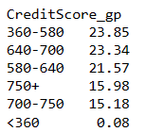
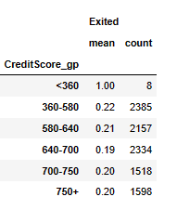
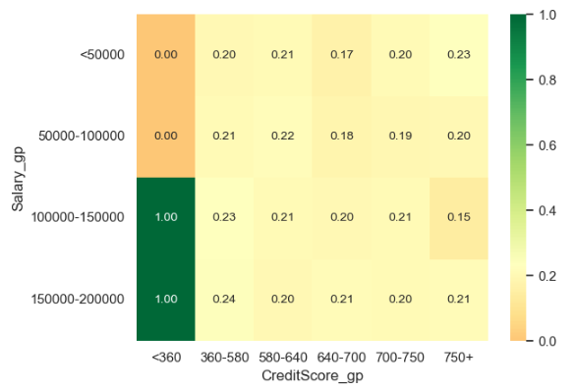
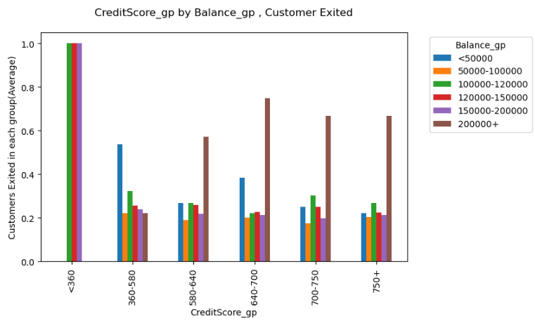
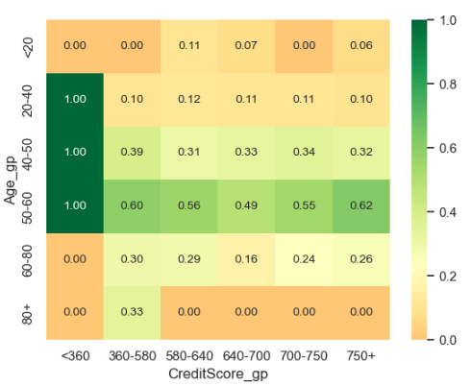
Exploratory Data Analysis
Credit Score – Exited Status
Customers having credit score below 360 with estimated salary and balance between 100k to 200k and age between 50-60 have exited the bank .
Credit Score and Age by Exit Status
Credit Score and Salary by Exit Status

Slide 9
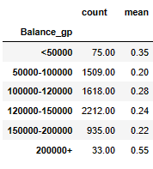
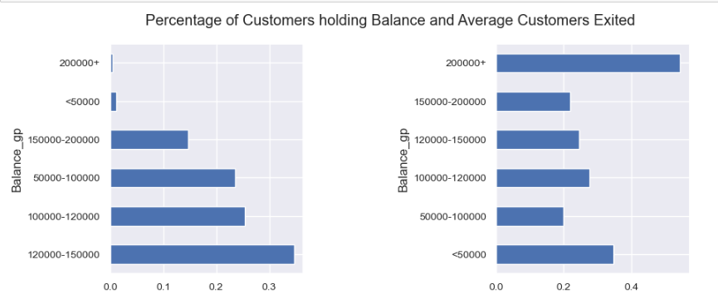
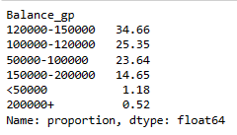
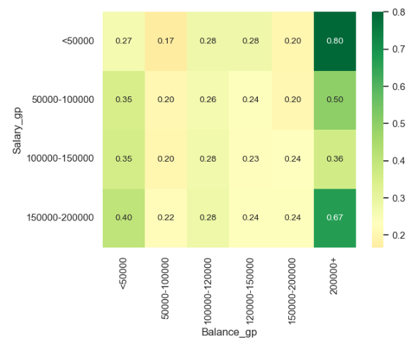
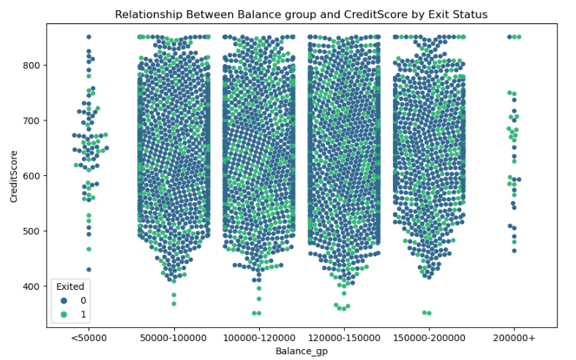
Exploratory Data Analysis
Balance-Exited Status
Conclusion:
The customers holding balance more than $200k are more likely to churn as compared to others.
From the above category, maximum customers had their estimated salary either less than 50k and more than 150k.
(Chi-square test)
Balance, Salary by Exit Status

Slide 10
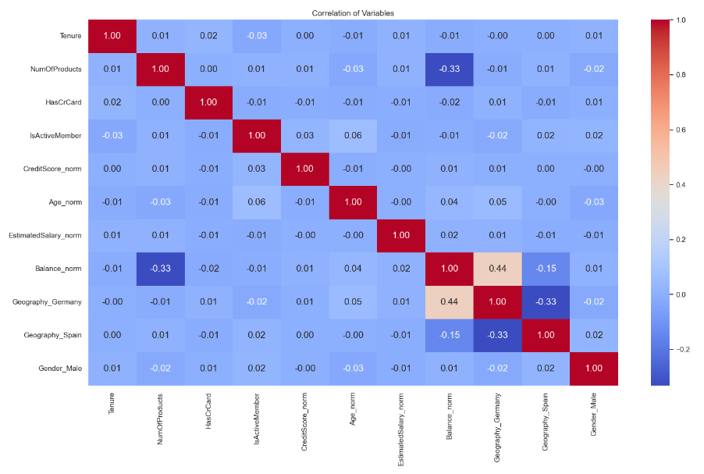
Correlation Matrix
Interpretations:
Geography_Germany and Balance_norm:
Moderate positive correlation (0.44): There is a significant moderately positive correlation between the variables and indicates customers from Germany to have higher account balance as compared to others.
Balance_norm and NumOfProducts:
Moderate negative correlation(-0.33): These two variables are inversely related. The customers with a higher number of products have lower account balances and vice versa.

Slide 11
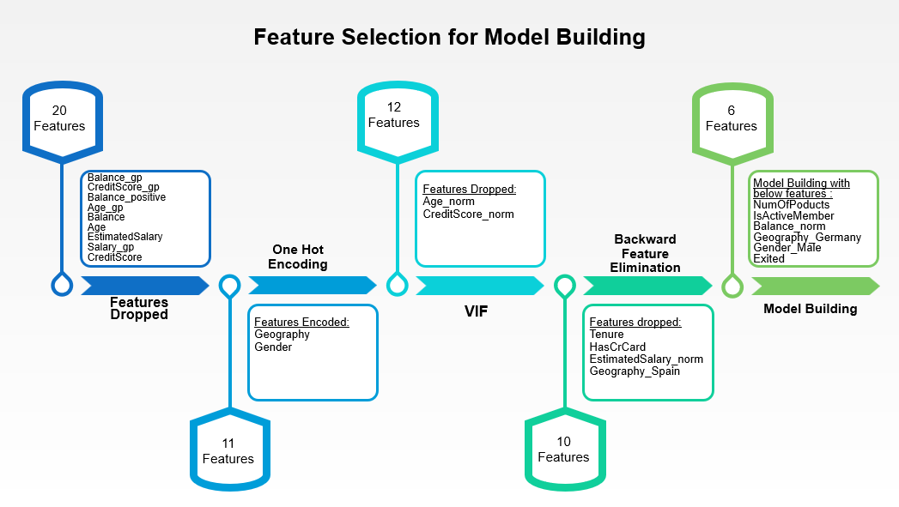

Slide 12
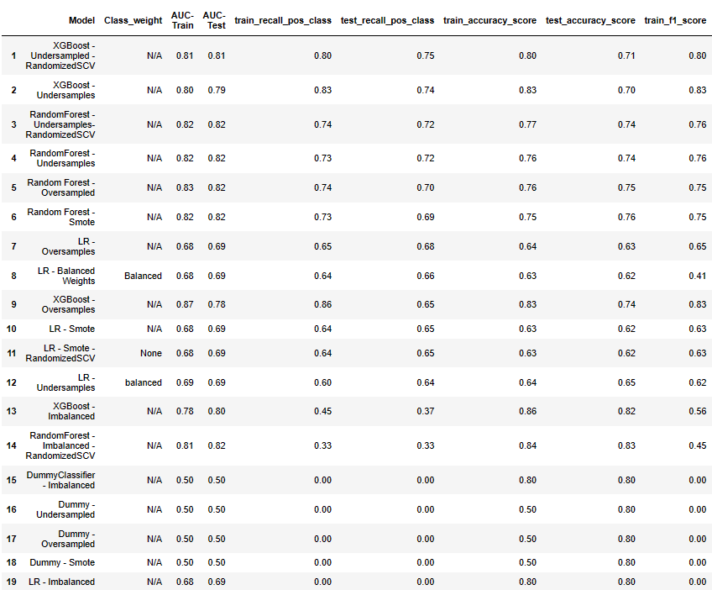
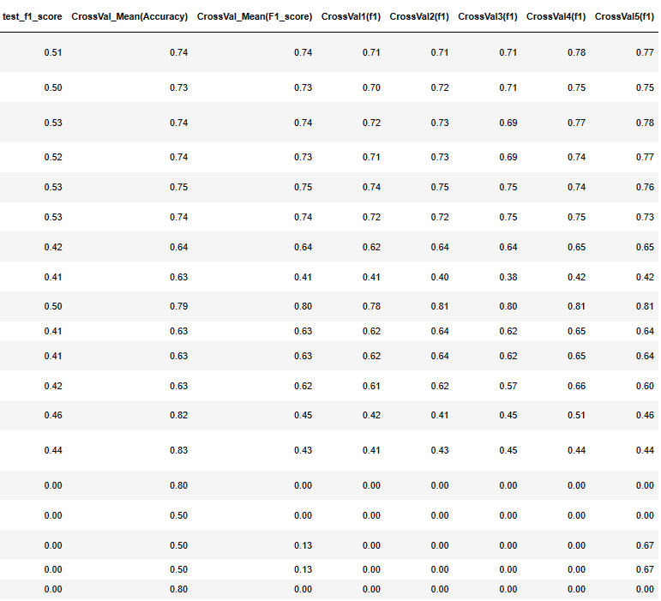
Model Training and Hyperparameter Tuning

Slide 13
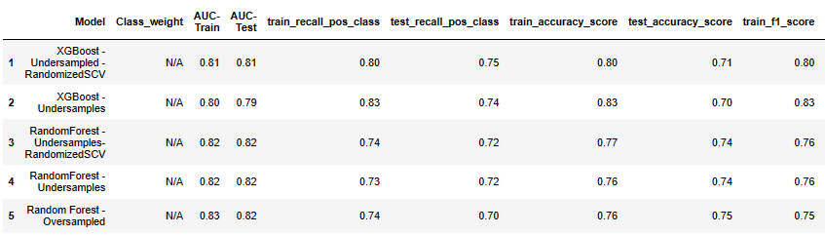
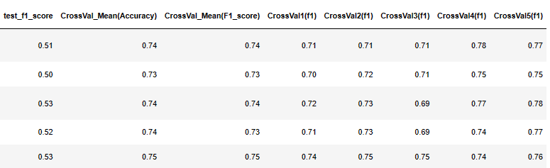
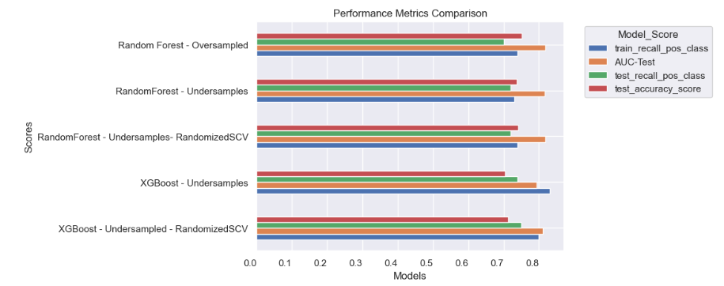
Model Evaluation
Based on the evaluation metrics, RandomForest – Under samples - RandomizedSCV model and XGBoost - Under samples - RandomizedSCV model seems to perform the best. Both have relatively high AUC scores, recall rates, accuracy scores, F1 scores, and cross-validation mean scores compared to other models.
Out of these two RandomForest - Undersampled - RandomizedSCV Model is likely the best choice among the given options.

Slide 14
Recommendations
Intervention: Leveraging the model's satisfactory recall rate, the bank should identify customers at risk of churn and offer personalized discounts or loyalty rewards to strengthen their relationship with the institution.
Increased Attention: To reduce the probability of churn, the bank should focus on providing an enhanced customer experience, improving service quality, and addressing pain points for customers.
Communication: Effective communication, including seeking customer feedback and keeping customers informed about business updates, can foster a closer connection with the organization and encourage customers to reconsider churning.
Focus on Inactive members: The company could focus on enhancing the engagement and retention strategies for inactive members. This might include targeted communication campaigns, personalized offers, or incentives to encourage inactive members to become more active and engaged with the company's products or services.
Geographical Correlations: Optimize product offerings based on geographical correlations, considering the higher account balances of customers from Germany, to enhance customer satisfaction and loyalty.

Slide 15
Conclusion
The model demonstrates fair performance overall, with an accuracy rate indicating the correctness in its predictions. Additionally, the recall rate of positive class suggests that the model effectively identifies a significant portion of potential churner customers, allowing the bank to allocate resources more efficiently and proactively mitigate churn.
While the predictive model produced encouraging findings, it is crucial to remember that customer churn is a complicated and dynamic process that is influenced by a variety of internal and external factors. In order to adjust to shifting consumer behavior and market conditions, regular monitoring and model development are advised.

Slide 16
Thank you

